Slide 1
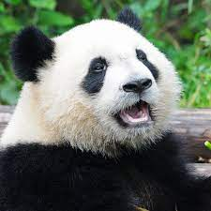
Content
Common & Scientific name of the animal
Systematic Position
General Behaviour
Feeding Behaviour
Breeding habit

Slide 2
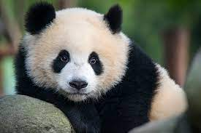
Gaint Panda
Common Name: Giant Panda
Scientific Name: Ailuropoda melanoleuca.
Presented by- Sahin Sumaiya
CU Roll No- 223144-11-0043
CU Reg No- 144-1215-0338-22

Slide 3
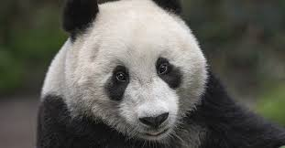
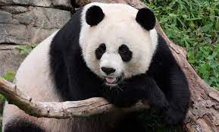
Systematic Position
Kingdom : Animalia.
Phylum: Chordata
Class: Mammalia
Order: cornivora
Family: Ursidal
Genus: Ailuropoda
Species: Melanoleuca.

Slide 4
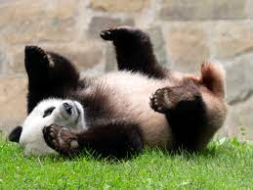
General Behaviour
Adult giant pandas may be generally solitary, but they do communicate periodically through scent marks, calls and occasional meetings. Recent research has also found that giant pandas may form communities of seven to 15 individuals within the local population.

Slide 5
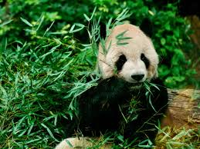
Feeding Behaviour
Though pandas are carnivores animal but they Consume bamboo as its diet mostly (about 99%)
They occasionaly eat
Grasses
Wild tuber
Meat in the form of birds, rodents, or carrion
In Captivity, they may receive honey, eggs, fish, yams, shrubs etc.

Slide 6
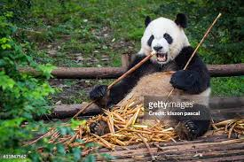
Feeding behaviour (Cont….)
The giant panda is a “Highly Specialized” animal with “unique adaptation”, and has live in bamboo forest for millions of years.
The average giant panda eats as much as as 9-14 kg of bamboo shoots a day.
The Giant Pandas spend about 16 hours in eating per day.

Slide 7
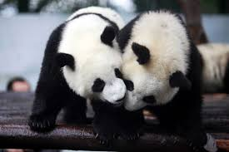
Breeding Habit
Male Panda Called Boars
Female panda called sow
Offspring called cubs
Giant pandas reach sexual maturity between ages of 4 and 8 years
Breeding takes place from March to May and Young are born 3 to 6 months later weighing only 85-140 gm.
Two cubs may be born but only one survive

Slide 8
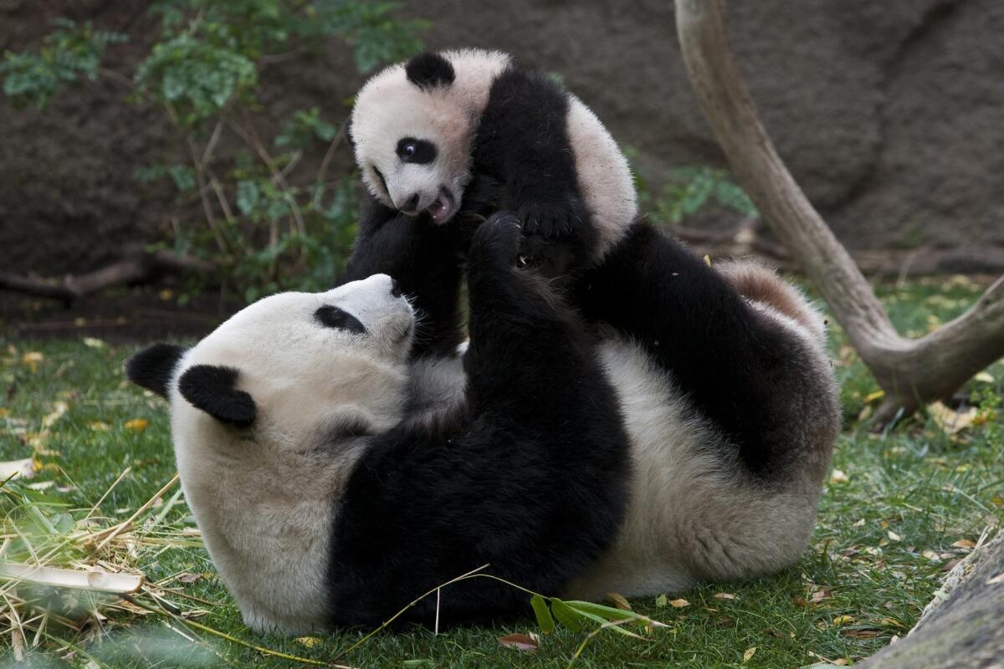
Breeding Habit (Cont..)
Reproductive rate- one cub every 2 years
The boar has no part in helping raise the cub
The cub stays with sow around 3 years of age.

Slide 9

Thank You

